Slide 1
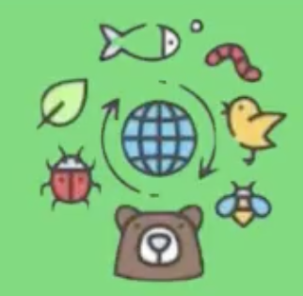
Plan for Improving Biodiversity Green Schools 2024-2025

Slide 2
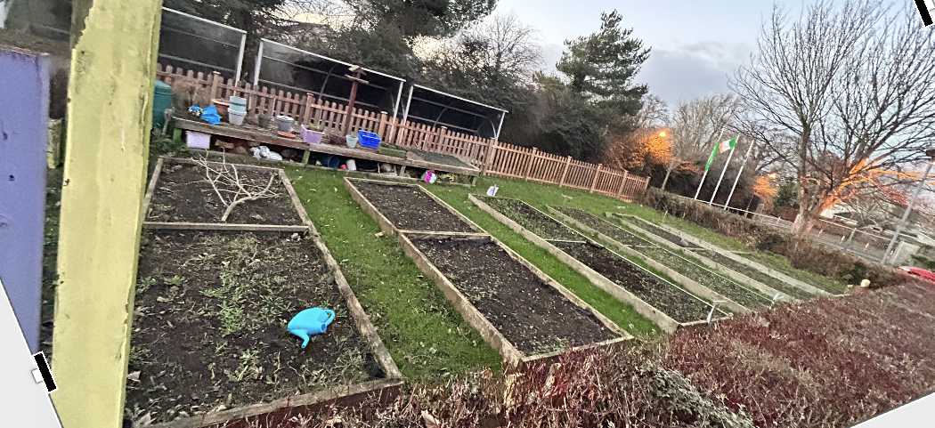
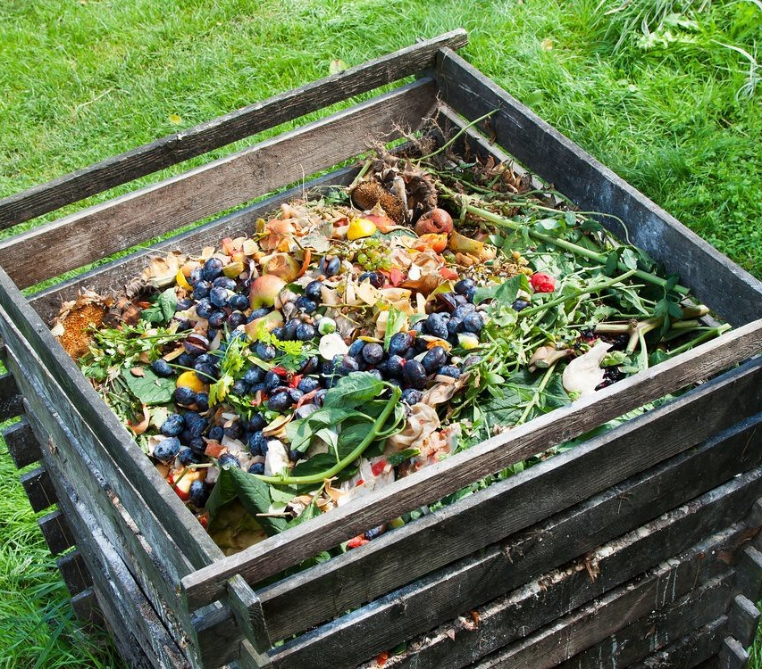
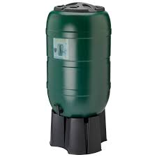
Plan for Garden
Tool Storage
Clear out / organise
Indoor storage area for tools that could rust
Take inventory of tools we have and what we need
Vegetable Beds
1 bed per class level (1st – 6th)
1 half for October planting, the other for March planting
Rotate class beds + crops each year to give soil a break
Compost Bin
6th class in charge
Water Butts
Circular

Slide 3
No Dig Garden
Weed by hand ensuring to remove roots of weeds.
Try to disturb the soil as little as possible.
If planting in Autumn spread organic compost / well rotten manure 5cm deep on the soil surface.
1 bag of manure / compost per square metre of growing area.
Rotate crops each year so they are grown in a new area – reduces build up of pests and diseases and gives the soil a break.
Before summer clear the beds and cover with compost and a tarpaulin.
Charles Dowding video - https://www.youtube.com/watch?v=OIojWdJz0RE
Growing Indoors
Use a mix of 2 parts organic peat free general purpose compost mixed with 1 part sand and 1 part horticultural grit.
The grit and sand create good drainage.
Fill the trays and pots with compost and place the seeds their own depth beneath the surface.
Position the seed trays in a sunny south facing windowsill and do not allow them to dry out.
Sometimes for a variety of reasons seeds fail to Germinate or the seedlings become too tall and leggy.
Where this happens it is possible to directly sow many crops outdoors a month later than the indoor sowing dates suggested.
There is also the possibility of buying some plants in modular trays from the garden centre as a back up.
https://www.heritageinschools.ie/content/files/Patrick-Hunt_Plan-of-Work-for-a-School-Garden.pdf?v=1581497137

Slide 4
Sample Planting Schedule
J.I | October | Mud Kitchen
 | March | Exploratory beds Using tools Looking for worms Planting acorns, pinecones and digging them up April Sprinkle wildflower seeds on a bare patch of ground rake and water in / make wildflower seed balls for throwing by mixing some soil, compost and seed in a bucket with a little water and shaping into little balls. These can be dried on a tray and flung on bare patches in the garden. Use native seed available from Wildflowers.ie .
S.I | October | Mud Kitchen
 | March | Exploratory beds / Indoor Planting Grass heads Sunflowers etc.
1st | October | Onions September – plant winter onion sets – push halfway down the soil with hairy root pointing down. 5x rows of onions 20cm apart (onions should be 10cm apart in the row) Place temporary net over bed to stop birds pulling out the onions Keep well weeded and watered Ready to harvest from mid - June https://www.quickcrop.ie/learning/video/onions
 | March | Lettuce - Varieties: 'Batavia red and green mix’ / 'Little gem’. March – sow lettuce into modular seed trays (a few seeds per module) April - plant out under fleece for protection May – June – will crop by removing larger outside leaves See https://www.youtube.com/watch?v=_pgcvN6TuE8
2nd | October | Garlic October – plant garlic in a small hole, twice their depth under the soil, 20 cm apart. Garlic will be ready in mid-June https://www.youtube.com/watch?v=_F4GM2zcrEI
 | March | Early peas - Varieties: 'Meteor', 'Dwarf meteor', 'Feltham first’. March – sow pea seeds into modular trays (3 seeds per module) April – move outdoors May – June – ready
Cosain |  | Link in with mainstream class for planting Sensory beds Exploratory beds Indoor planting

Slide 5
3rd | October | Perpetual Spinach September – grow perpetual spinach in modular trays, 2 seeds each October – plant out 30cm apart May - ready https://www.youtube.com/watch?v=fE59HrNodZY
 | March | Pakchoi Pakchoi is grown in the same way as Lettuce See https://www.youtube.com/watch?v=_pgcvN6TuE8
4th | October | Sensory Area Tend and plant new herbs, flowers and perennial edibles Avoid planting Mint, Lemon Balm and Fennel as they spread easily. Plant some perennial kales and cabbages which will grow for many years and plant new perennial flowers and grasses which come back year after year.
 | March | Early beetroot - Variety: 'Bolthardy’. February – sown indoors in modular trays Mid-April – plant outdoors June - golf ball sized baby beets can be harvested
5th | October | Plant Bulbs October cut the grass short and sprinkle yellow rattle seeds. Plant a selection of spring and summer bulbs in this area. Dig a 20cm hole putting in groups of bulbs such as daffodil, tulips etc. The yellow rattle will supress grass growth, the bulbs will come through. Allow the grass to grow until the following October when it can be cut and raked for removal once a year in subsequent years
 | March | Scallions - Varieties: ‘Ishikura bunching’ March sow scallions in modular trays or small pots Place 10 seeds in each module and grow as a bunch April – plant out 20cm apart. June – ready https://www.quickcrop.ie/learning/video/spring-onions
6th | October | Composting Throughout school year take on the management of the compost system. Add a 50 /50 mix of brown and green materials in thin layers. Turn the compost heap in the Autumn and harvest for use in the garden. https://patshunts2002.wordpress.com/2014/03/09/hot-compostingusing-coffee-grounds/
 | March | Potatoes - Varieties: 'Milan purple top, 'Tokyo cross’ Feburary - Chit early potatoes in egg cartons in the classroom. Mid-March - plant chitted potatoes into their bed at 25 cm spacing in the row with 3 rows in the bed. 12 seed potatoes per 1m2. Plant 15cm deep and as they grow add more compost around the plants. Water well, especially when flowering as this indicates tubers are swelling. Mid-June – harvest 12 weeks after planting See https://www.youtube.com/watch?v=zXO_j0vriwk

Slide 6
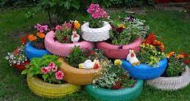
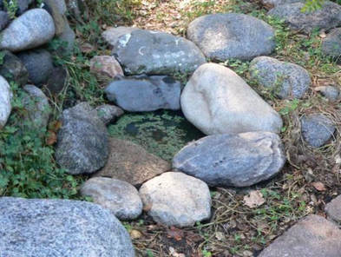
Plan for Outdoor Classroom Area
Exploratory Bed(s)
1 or 2 beds for exploratory gardening
Mud Kitchen
1 large mud kitchen
Sensory Area
Sight – colourful flowers e.g. Dahlias and Sunflowers or spiral garden mobiles / painted bold colours / painted stones
Sound – pollinator plants or wind chimes
Smell – lavender / herbs
Touch – celosia or chenille plant / mud kitchen / textured pots
Taste – edible flowers / vegetable patch at front of school
Pond
1 small pond – either a dish or proper lined

Slide 7
To Do List
Green Team Jobs
Make bird feeders
Decide on type of school pond to build
Organise school garden tools
Parental Support
Ask for volunteers who are interested in gardening
Fundraising with PTA? (check for grants / donations)
Volunteers to help clear outdoor classroom area?
Community Support
Contact local businesses for donations
Contact local tidy towns for support
Contact local mens shed to ask about mud kitchen

